Slide 1
Soccer Player Transfer Value Prediction
Football
DurianCandy
Sunny Kwong Charles Siu
Sean Tey Andrew Young

Slide 2
Agenda
Intro
Dataset
Data Wrangling
Model Selection
Findings & Conclusion

Slide 3
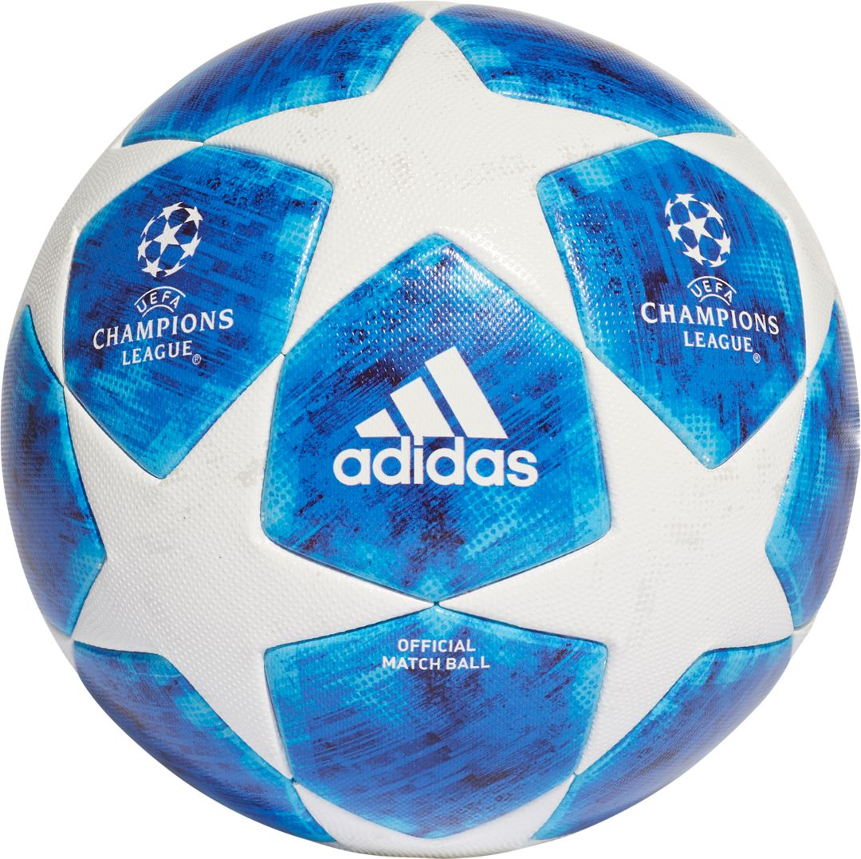
Notes:
How do you even remember all those numbers

Slide 4
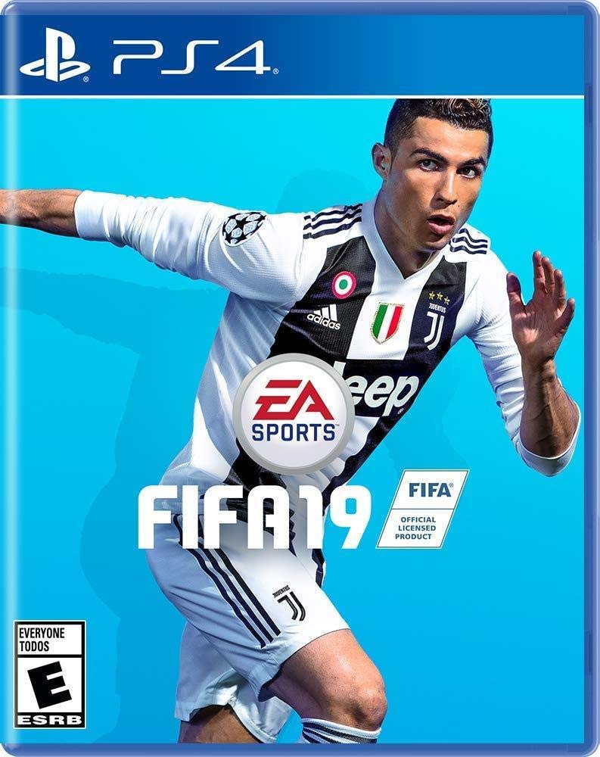

Slide 5
Why are some soccer players worth more than others?

Slide 6
Dataset
Title: FIFA 19 Complete Player Dataset
Source: Kaggle, originally from sofifa.com
Link: https://www.kaggle.com/karangadiya/fifa19
Shape:
89 Columns x 18,207 Observations
Each observation represents a soccer player in FIFA 19
Each column represents an attribute of the player

Slide 7
Can we predict the value of a soccer player in the transfer market from their ratings and characteristics ?

Slide 8
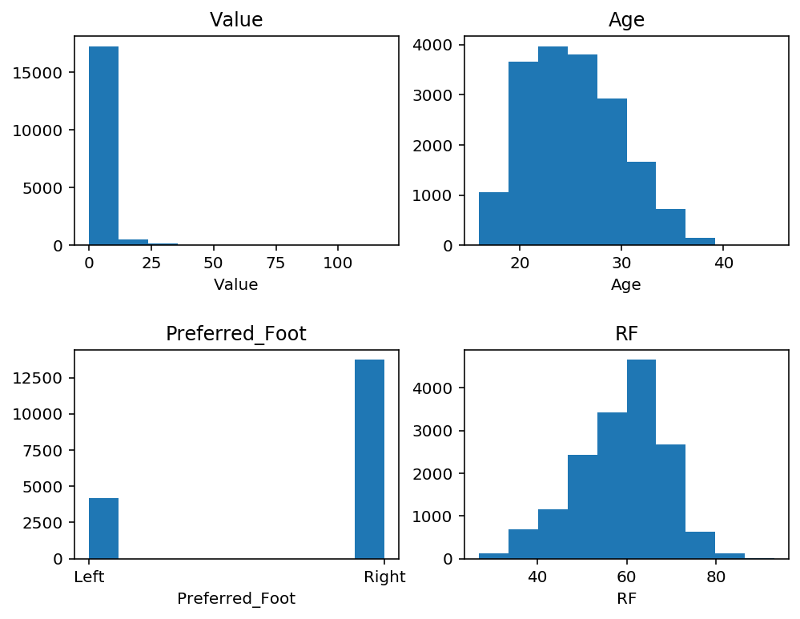
Data Wrangling
Columns
Added columns related to soccer leagues e.g. Country, Pyramid Level, Revenue Per Team
Dropped extraneous ID and corrupted columns e.g. Player Name, Body Type, Photo
Derived columns based on existing columns e.g. Loan Out from Loaned From and Club
Rows
Dropped rows that have zeros for Value (target)

Slide 9
Model Selection
We wanted to be able to interpret our models so we tried:
Basic Linear Regression
L1 Regularized Regression
Random Forest
Random Forest seems to perform the best with MedAE of (15, 330 euros).
We are considering using Symmetric mean absolute percentage error (sMAPE)
Notes:
We chose these three models since they are good at interpret the model
In the end, we picked RF as our final model since it performs the best
This means we will be using R.F. Permutation Importance to interpret the model.
relative percentage is more informative for dollar values.
However, scikit-learn does not have a built-in sMAPE function so we will have to write our own.

Slide 10
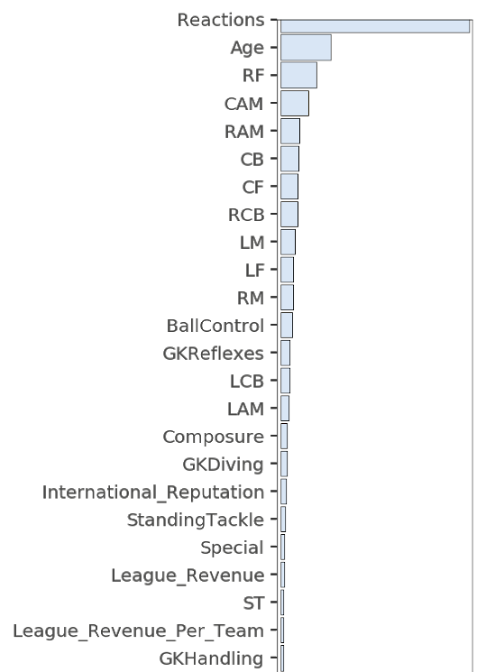
Findings & Conclusion
Reaction is the most important
Age matters
Attacking players are more predictive than defensive players
Other important attributes
Ball control
Goalkeeper reflexes
Notes:
Reactions measures how quickly a player responds to a situation happening around him. It has nothing to do with the player’s speed. A player can be really fast but at the same time have low reaction capacity.
More goals = More excitement = more money?
But for now, we are not sure if an older player is more valuable or less valuable
Since younger players have more potential and old players have more experience

Slide 11
Thank you

